Slide 1
Q1 2017 Report
Jan Wahlström
CEO
jan.wahlstrom@elosmedtech.com
0702 12 18 89

Slide 2
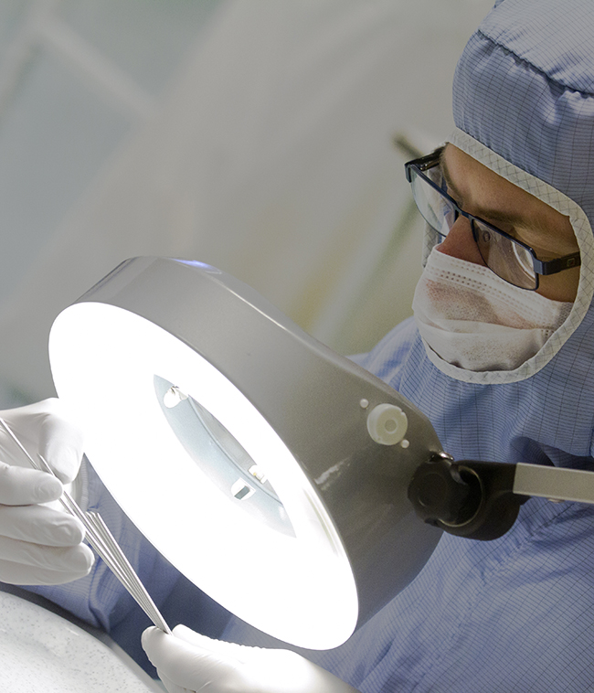
Short Facts Elos Medtech
Elos Medtech AB is listed on Nasdaq OMX Stockholm AB since 1989.
Global sourcing at 5 production sites:
Sweden, Skara and Timmersdala
Denmark, Görlöse
China, Tianjin
USA, Memphis
Number of employees: 520
Medical device customers world-wide
Certifications: ISO 13485, ISO 9001, ISO 14001, ISO 17025 in compliance with the requirements within MDD 2007/47/EC and registered by FDA (21 CFR 820

Slide 3
Total commitment
Solution Partner for the medtech industry
OEM products
Medical device competence
Increased efficiency & effectiveness
Lead time
Customised solutions
Quality
Time to market

Slide 4
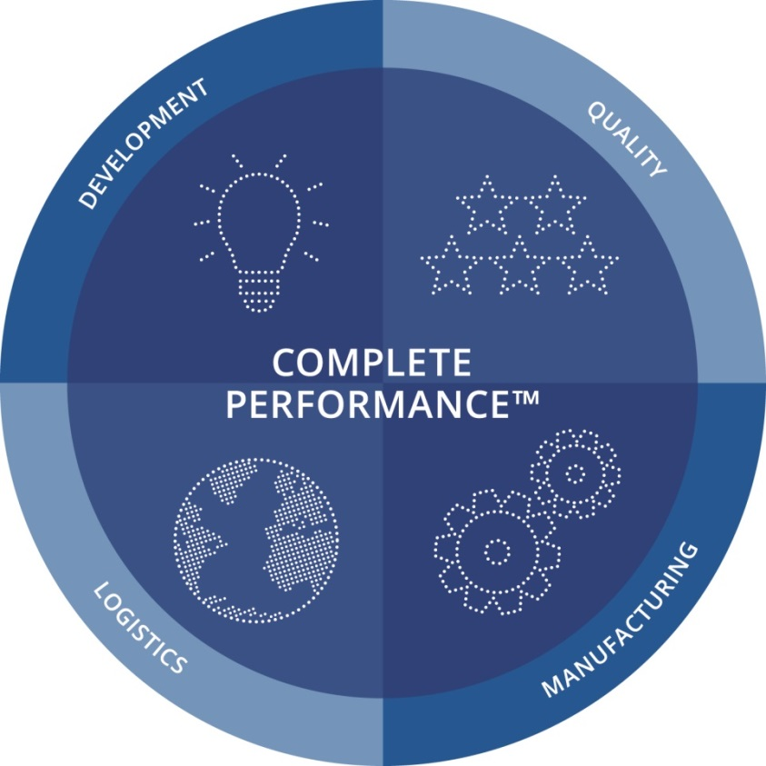
Elos Medtech Complete Performance™
Solution partner for the medtech industry
The unbroken chain from design and manufacturing, to packaging, distribution and logistics.
Notes:
Our Way of Working is based on what we call Complete Performance™.
The concept means that we as a solution partner take responsibility for all steps throughout the process from development, design and construction to production and delivery of finished products.
We function as your strategic development and production partner.
This is a strategic way of working which is built on our high competence and deep understanding of the product’s application together with a close cooperation with our customer.
Focus on your core business while we take care of your product process
Regardless of the segment, we supply you with individual, complete solutions, generating savings or improving efficiency based on our total commitment. This allows you to focus on your core competence and core business.

Slide 5
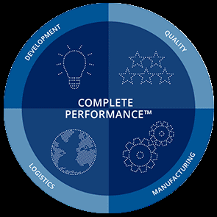
Summary
2017 Q1
  Sales 140,9 MSEK (140,4)
  EBITDA 26,9 MSEK (25,3)
  EBIT 13,3 MSEK (12,0)
  Operating result +11%
  Result after financial net +41%
  Net earnings per share +49%
Geographies
  Asia and Denmark strong performance in Q1. Sweden is stable. US and orthopedics down vs. Q1 in 2016, but strong performance in March.

Slide 6
Improved profitability and margins
Koncernen
 | Jan-mar | Jan-mar | Apr-mar | Jan-dec
 | 2017 | 2016 | 2016/17 | 2016
Nettoomsättning, mkr | 140,9 | 140,4 | 552,5 | 552,0
Tillväxt, %* | -1,7 | 34,5 | 2,2 | 10,1
EBITDA, mkr | 26,9 | 25,4 | 98,8 | 97,3
EBITDA, % | 19,1 | 18,1 | 17,9 | 17,6
Rörelseresultat, mkr | 13,3 | 12,0 | 44,0 | 42,7
Rörelsemarginal, % | 9,4 | 8,5 | 8,0 | 7,7
Resultat efter finansiella poster, mkr | 9,6 | 6,8 | 40,7 | 37,9
Resultat efter skatt, mkr | 7,2 | 4,9 | 28,7 | 26,4
Resultat efter skatt per aktie, kr | 1:19 | 0:80 | 4:74 | 4:37
* Justerat för valutakursförändringar.

Slide 7
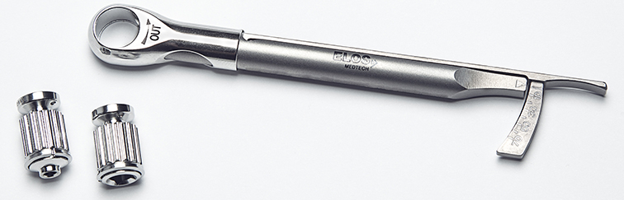
Strategic objectives
Strategic Objective | Target | Q1 2017 (2016)
Growth | 10% YoY | 0,4% (10,1*)
EBIT Margin | 13% | 9,4% (7,7)
Return on Equity | 15% | 8,1% (7,6)
Return on operating Capital | 15% | 7,1% (5,7)
Share risk-bearing capital | >30% | 45,3%(41,3)
Liquidity | 6-12% | 14% (16)
* incl. Onyx acquisition in April 2015

Slide 8
Markets we serve

Slide 9
Markets
New definition on markets
Good development in Dental Implant Systems continues
Omsättning per marknad | Jan-mar | Jan-mar | Apr-mar | Jan-dec
Mkr | 2017 | 2016 | 2016/17 | 2016
Dental Implant Systems | 51,5 | 36,2 | 186,4 | 171,1
Diagnostics | 6,4 | 8,2 | 27,9 | 29,7
Hearing Device & Vibration | 18,5 | 21,8 | 76,8 | 80,1
Orthopedics | 39,0 | 50,8 | 170,4 | 182,2
Other Medical Areas | 25,5 | 23,4 | 91,0 | 88,9
Total nettoomsättning | 140,9 | 140,4 | 552,5 | 552,0

Slide 10
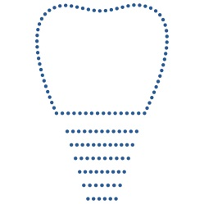
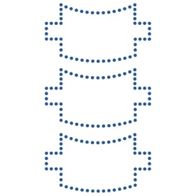

Markets we serve
Dental Implant Systems
Implants, prosthetics and instrument with complicated geometries and surface structures
Orthopedics
Implants, screws, plates, pins and wires, and related instruments such as drills and other surgical instruments
Diagnostics
Details and components used in tests of allergies, autoimmune diseases and similar types of analysis

Slide 11

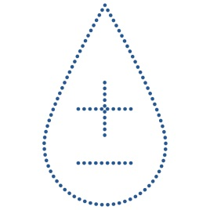

Markets we serve
Hearing Device & Vibration
Bone-anchored hearing implants, components for traditional hearing aids and products for advanced technical solutions within vibration and sound
Other Medical Areas
Small plastic details and components with extreme tolerances within cardiac rythm management, neurosurgery and radiation oncology.
Components for multi-injection systems for diabetes treatment

Slide 12
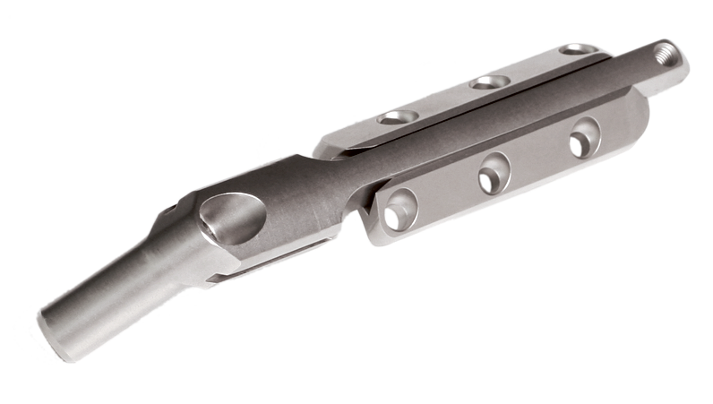
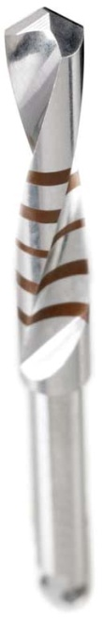
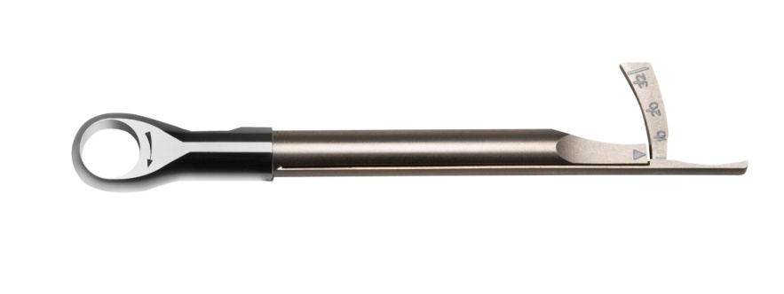
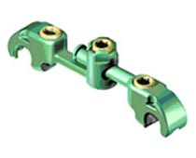
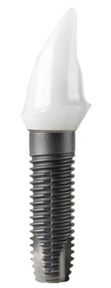
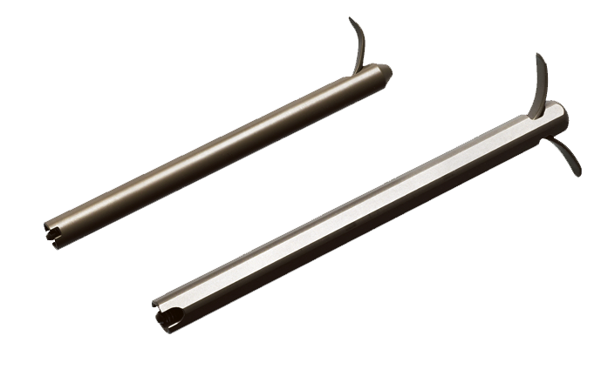
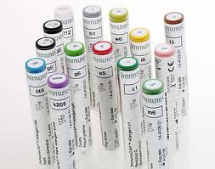
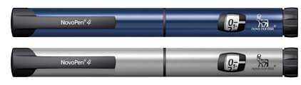
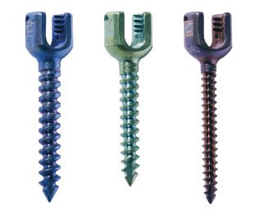
Products
Instruments
Implants
Diagnostics

Slide 13
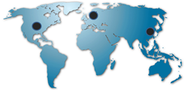
Long-term strategy for growth
Our objective is to build up a leading global
group supplying as a contract manufactorer to selected segments within the medical device sector.
Complement with own products
This position should be obtained through organic growth and acquisitions.
Complementary acquisitions to strengthen our market position and develop our customer base.
Organic growth trough:
Increased capacity
Increased efficiency
Introduction of new own products

Slide 14
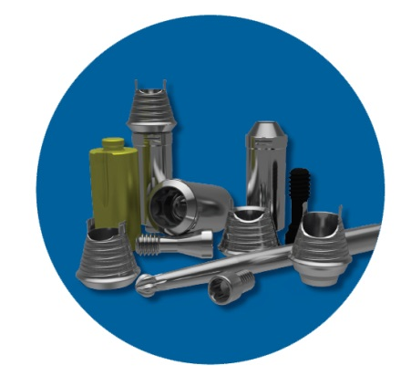
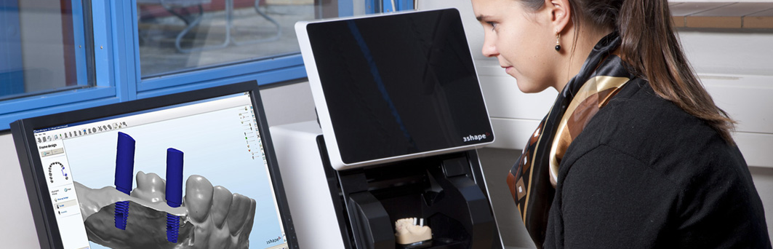
Continued development of own products
Elos Accurate®
A comprehensive digital dentistry solution based on reducing complexity for dental laboratories and prosthetic active dentists
The components are integrated into the scanner software (3shape, Exocad and DentalWings)
Torque Wrench

Slide 15
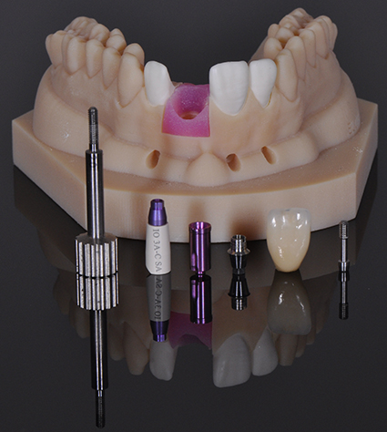
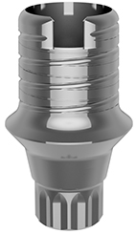
Own products – New product launch
Launched new products in the Elos Accurate family in Q3 and Q4
5 new HC in sales recruited YTD
Sales through distributors

Slide 16
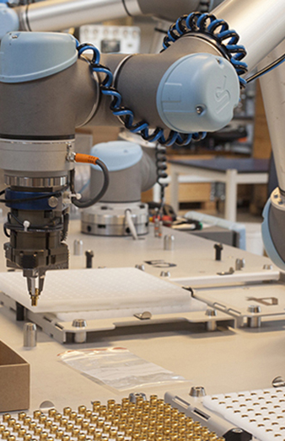
Elos Medtech Complete Performance™ and the automated factory
We have invested in automation, and streamline processflows
We serve the customer through the product lifecycle from
  R&D
  Regulatory
  Validations
  Production of parts or complete products
  Delivery
    Dock to stock
    VMI
    Clean room
    Sterile solutions

Slide 17
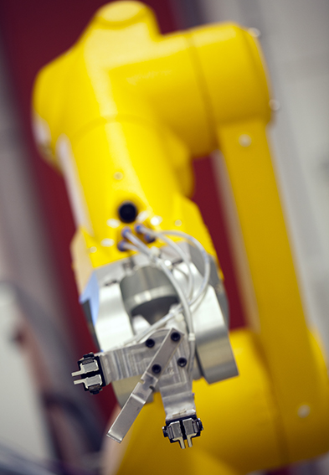
We are well positioned for growth
We are equipped for further growth:
“World class” quality
Strong productivity development
Capacity for growth
Continually advance manufacturing methods
Broadening our expertise in new techniques
OEM solutions within dental implants and spine

Slide 18

Questions ?

